Slide 1
EVAPI - Enumeration
Auburn Hacking club
https://goo.gl/aXX18b

Slide 2


This Week
https://goo.gl/aXX18b
Notes:
CCleaner started serving malware when you downloaded updates in August – recently acquired by Avast in July

Slide 3
EVAPI
Enumeration
Vulnerability Scanning
Access
Privilege Escalation
Implant
Notes:
Recap what EVAPI is and means – compare it to software process (not a waterfall)
Talk about what Enumeration is

Slide 4
Enumeration Environment
Internal Networking
Outside a Network ~ Wireless
Outside a Network ~ Other
Notes:
Internal network = finding networking devices (other boxes, servers, etc)
Outside network: Finding wireless, or finding other things (SDR, Bluetooth, etc)

Slide 5


Networking World
Subnet
Packets
IP Address
Port
Routing
Notes:
Quickest Introduction to Networks anyone has ever seen

Slide 6
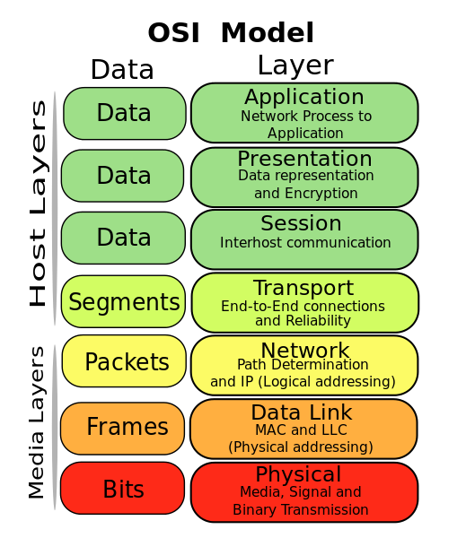
Basic Bitch Networking Tools
Ipconfig / Ifconfig
Ping
Tracert / Tracepath / Traceroute
Nslookup
Netstat
Ssh / telnet / puTTy

Slide 7
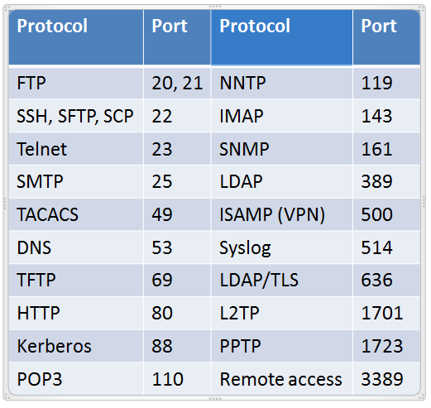
Port Scanning
Probing Ports -> Analyzing Results
Open vs Filtered vs Closed
Secure on Wire vs Insecure
SSH vs Telnet / SFTP vs FTP

Slide 8
Popular Types of Port Scans
ARP Scan
TCP Scans
Vanilla, SYN, FIN, IDENT, XMAS, ACK
UDP ICMP Scans
Notes:
Address Resolution Protocol (ARP) scan:
In this technique, a series of ARP broadcast is sent, and the value for the target IP address field is incremented in each broadcast packet to discover active devices on the local network segment. This scan helps us to map out the entire network.
Vanilla TCP connect scan:
It is the basic scanning technique that uses connect system call of an operating system to open a connection to every port that is available.
TCP SYN (Half Open) scan:
SYN scanning is a technique that a malicious hacker uses to determine the state of a communications port without establishing a full connection. These scans are called half open because the attacking system doesn’t close the open connections.
TCP FIN Scan:
This scan can remain undetected through most firewalls, packet filters, and other scan detection programs. It sends FIN packets to the targeted system and prepares a report for the response it received.
TCP Reverse Ident Scan:
This scan discovers the username of the owner of any TCP connected process on the targeted system. It helps an attacker to use the ident protocol to discover who owns the process by allowing connection to open ports.
TCP XMAS Scan:
It is used to identify listening ports on the targeted system. The scan manipulates the URG, PSH and FIN flags of the TCP header.
TCP ACK Scan:
It is used to identify active websites that may not respond to standard ICMP pings. The attacker uses this method to determine the port status by acknowledgment received.
UDP ICMP Port Scan:
This scan is used to find high number ports, especially in Solaris systems. The scan is slow and unreliable.

Slide 9

Fingerprinting
Active vs Passive
Detection of modification of packets
Service Information
Banner grabbing
Notes:
Active (most common): sending data to a system to see how the system responds.
Passive: examining traffic on the network to determine the operating system rather than generating network traffic by sending packets to them
Common techniques are based on analyzing:
IP TTL values.
IP ID values.
TCP Window size.
TCP Options (generally, in TCP SYN and SYN+ACK packets).
DHCP requests.
ICMP requests.
HTTP packets (generally, User-Agent field).

Slide 10

Tools
nmap
Zenmap, sparta
Mass-scan
Nessus / Vuln Scanners
Specific Tools
Snmpwalk, arp-scan, etc

Slide 11
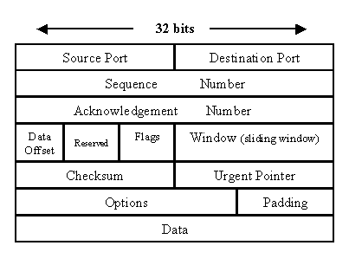
On-The-Line Information Gathering
Man in the Middle
Wireshark
Packet Inspection / Analysis aka Sniffing
Wtf is a packet

Slide 12
WiFi World
Basically the last world with less wires
Increases attack surface
SSIDS, Channels,
WEP vs WPA2
Second Tier Auth Protocols

Slide 13
Everything else
Radio Frequencies
SDR
Over the air protocols
Zigbee
Bluetooth
NFC

Slide 14
Contact Info, Website, etc, etc, etc
v@auburn.edu | mr@auburn.edu
auctf.github.io
https://goo.gl/aXX18b

